Slide 1




Extend the Power Platform with Custom Connectors
Daniel Laskewitz• @Laskewitz

Slide 2
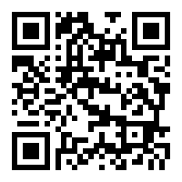
Code of Conduct
As event and experience organizers, we seek to provide a respectful, friendly, professional experience for everyone, regardless of gender, sexual orientation, physical appearance, disability, age, race or religion.
We do not tolerate any behavior that is degrading to any gender, race, sexual orientation, or disability, or any behavior that would be deemed harassment or discrimination.
Individuals are responsible for knowing and abiding by our standards and we encourage everyone to assist in creating a welcoming and safe environment. Please report any concerns, suspicious or disruptive activity or behavior to the organizing team, so that we can address the issue immediately.
More information can be found on the CollabDays Belgium & Netherlands website at https://www.collabdays.org/2021-benl/about

Slide 3
























Our Platinum Sponsors
Community Sponsor
Our Gold Sponsors

Slide 4
Agenda
What is a connector?
Why custom connectors?
Develop a connector
Types of connectors
Independent Publisher Connectors
Power Platform Connectors CLI
Resources
Wrap up

Slide 5

What Is A Connector?

Slide 6
What Is A Connector?
A formal definition of a REST API
Allows the REST service to talk to Microsoft Power Apps, Power Automate, and Logic Apps
Currently 550+ (!!!) connectors in the product
API Properties
OpenAPI
Binary
Connector

Slide 7
Why Custom Connectors?

Slide 8
Why custom connectors?
Add services that are not currently supported
Expand connectors that currently don’t have the trigger/action you want
Custom connectors are simple to build, don’t require a lot of coding
Can be build using the wizard, a postman collection, or even just with Visual Studio Code, or Notepad
Can be shared, packaged, and certified via GitHub

Slide 9
Develop A Connector

Slide 10
Develop a connector
Read / know the API you want to build a connector for
Start in one of the products (Power Apps, Power Automate or Logic Apps)
Set up the authentication
Define the operations for your connector
Save and test your connector

Slide 11
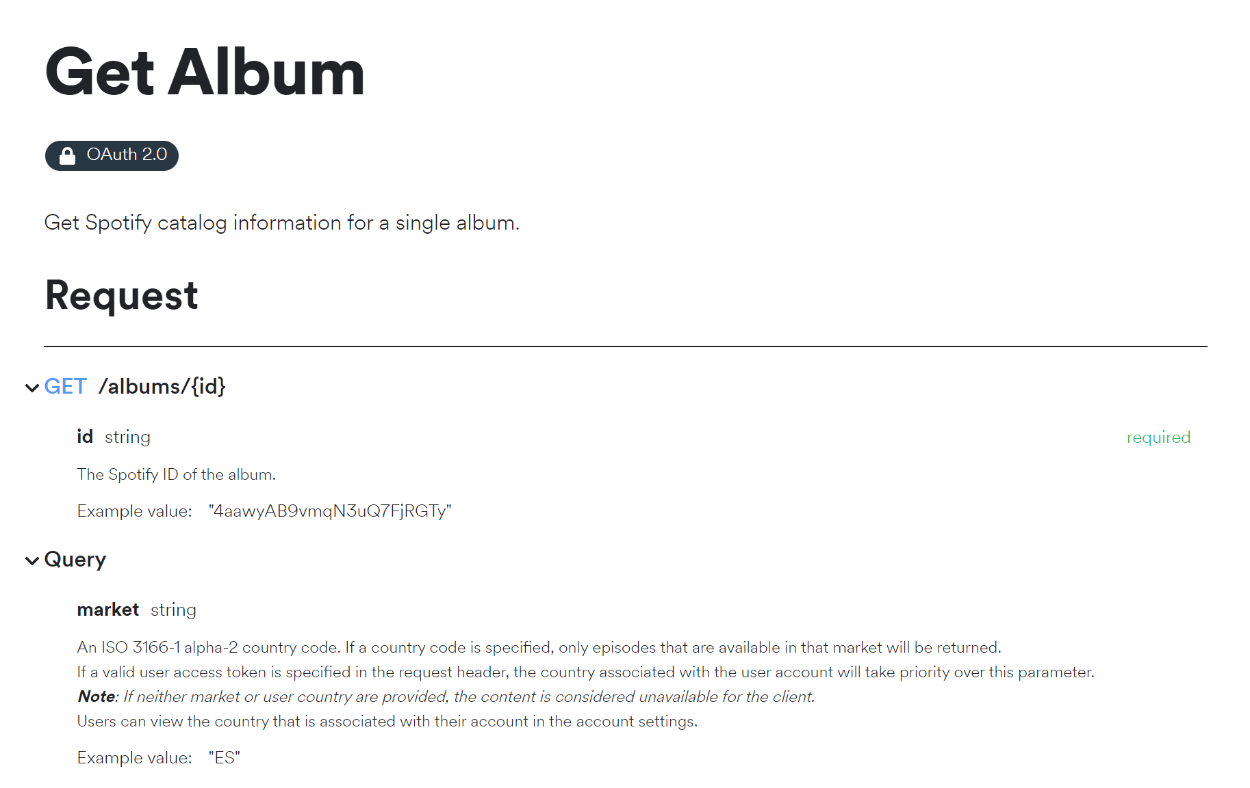
Develop a connector: Read / know the API
Look at the API Documentation
A lot of good APIs have good documentation with samples which you can reuse later on

Slide 12
Develop a connector: start in one of the products
Create from blank
Azure Service (preview)
OpenAPI file
OpenAPI file from URL
Postman Collection
GitHub

Slide 13
Develop a connector: set up the authentication
In the demo we will use anonymous auth, but you can use a lot more types of authentication:
Anonymous
Basic (username + password)
API Key
Oauth 2.0 (cloud only) – Including Azure AD
Windows (on-prem only)

Slide 14
Develop a connector: define the operations for your connector
Import the request and response from a sample payload
Actions, triggers, policy templates, and C# code (*)
Add advanced ‘features’

Slide 15
Develop a connector: save and test your connector
You can just save it in the wizard and start testing
You can also use the Power Platform Connectors CLI to deploy

Slide 16
DEMO: Build your first connector

Slide 17
Types Of Connectors

Slide 18
Types of connectors
Connector Type | API Availability | Service Owner | Audience
Custom | Public or Private | Connector developer or someone else | Internal consumption
Certified | Public | Connector developer | Everyone
Independent Publisher | Public | Someone else | Everyone

Slide 19
Independent Publisher Connectors

Slide 20
Independent Publisher connectors
An Independent Publisher connector is a premium connector developed and maintained by one or more Independent Publishers
The connectors are submitted to the Power Platform Connectors GitHub repository
Internal validation and certification process
Independent Publishers can be developers from companies, community members, or other enthusiasts

Slide 21
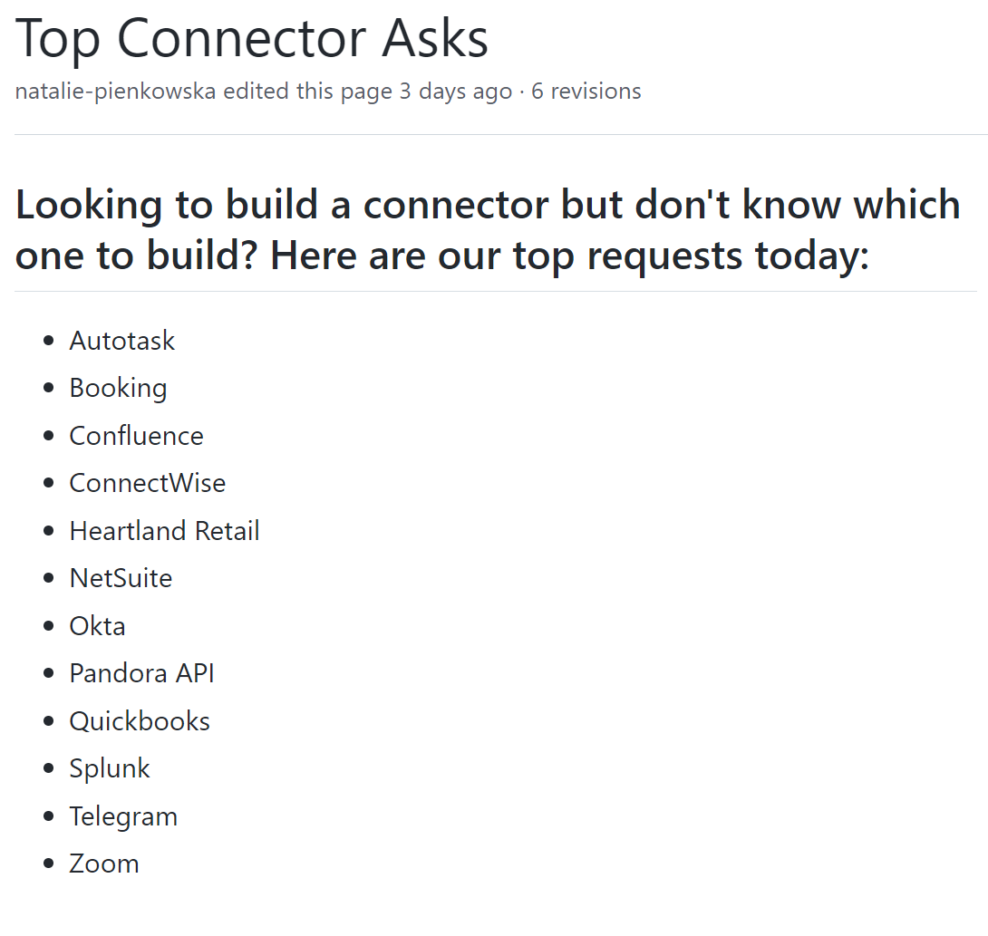
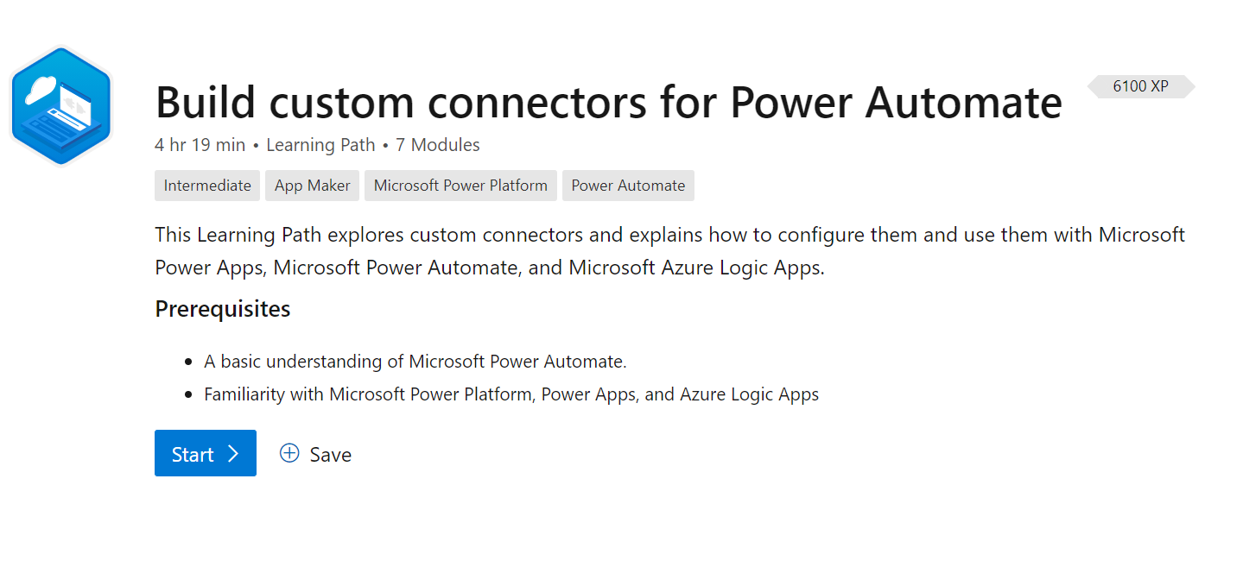
Step 1 - Build a custom connector
Choose a connector from the “Top Connector Asks” or think about the products you use on a regular basis
Start building in Power Apps, Power Automate, or Logic Apps through an OpenAPI definition, Postman V2, or from the in-product wizard

Slide 22
Step 2 - Prepare your artifacts
You will be submitting API Definition (Swagger), API Properties, & readme.md (for documentation) files.
Use the CLI to download the artifacts and add metadata such as publisher and stackOwner.
Make sure you’ve added 1) summaries and descriptions for your parameters and 2) schemas!

Slide 23

Step 3 - Submit to GitHub
Create your pull request and title it “Connector Name (Independent Publisher)”
Paste screenshots that show your operations are working within a Flow, that the entire Flow has succeeded, and the Tests operations section.
You don’t need to submit an icon because we have a generic Independent Publisher connector icon!
Upon submission, you’ll see a “Swagger Validator” run and provide results.

Slide 24
Step 4 - Follow through with comments during certification
Our certification engineer will test your connector and do manual validations to make sure that the connector is of high quality.
This process takes at least 2 weeks.
Read the GitHub labels to understand status: Validation phase -> certification phase -> deployment phase
Submit an update to the connector anytime after it’s deployed!

Slide 25
Step 5 - Time to show off your connector!
Check out your connector in the product!
Share your connector from your LinkedIn and Twitter accounts
Monthly new Independent Publisher connector blog released by Microsoft
Monthly Coffee Chat
Opportunities to demo
Bi-weekly PnP Microsoft Dev call on Thursdays
YouTube video recording for Microsoft Dev channel

Slide 26
Power Platform Connectors CLI

Slide 27
Power Platform Connectors CLI
The CLI helps with the ALM story of Custom Connectors
You can deploy, download and update your connectors with the CLI through the following commands:
Paconn login
Paconn download
Paconn create
Paconn update (*)

Slide 28
DEMO: Download & update the connector

Slide 29
Resources

Slide 30
Resources (1/2)
Docs https://aka.ms/connectors
Get your connector certified https://aka.ms/ConnectorCertification
Power Platform Connectors GitHub repository https://github.com/Microsoft/PowerPlatformConnectors
Extend an OpenAPI Definition https://docs.microsoft.com/en-us/connectors/custom-connectors/openapi-extensions
Custom code in custom connectors https://docs.microsoft.com/en-us/connectors/custom-connectors/write-code

Slide 31
Resources (2/2)
Create a connector from a Postman Collection https://docs.microsoft.com/en-us/connectors/custom-connectors/define-postman-collection
Custom Connectors Coding Standards https://docs.microsoft.com/en-us/connectors/custom-connectors/coding-standards
Policy support in Custom Connectors https://docs.microsoft.com/en-us/connectors/custom-connectors/policy-templates

Slide 32
Wrap up

Slide 33
Wrap up
Check out the top connector asks on GitHub and pick one
Go build your first connector
Test, test, test!
Spread the word about custom connectors

Slide 34
Thank you!

Slide 35
Our Platinum Sponsors
Community Sponsor
Our Gold Sponsors

